Slide 1
Chapter 2 Containerization with Docker

Slide 2
Learning Topics
Overview of Docker
Docker Architecture
Container & Images
Docker Hub
Dockerfile
Dockerize Apps in .NET, Python and Java
Docker Best Practices

Slide 3
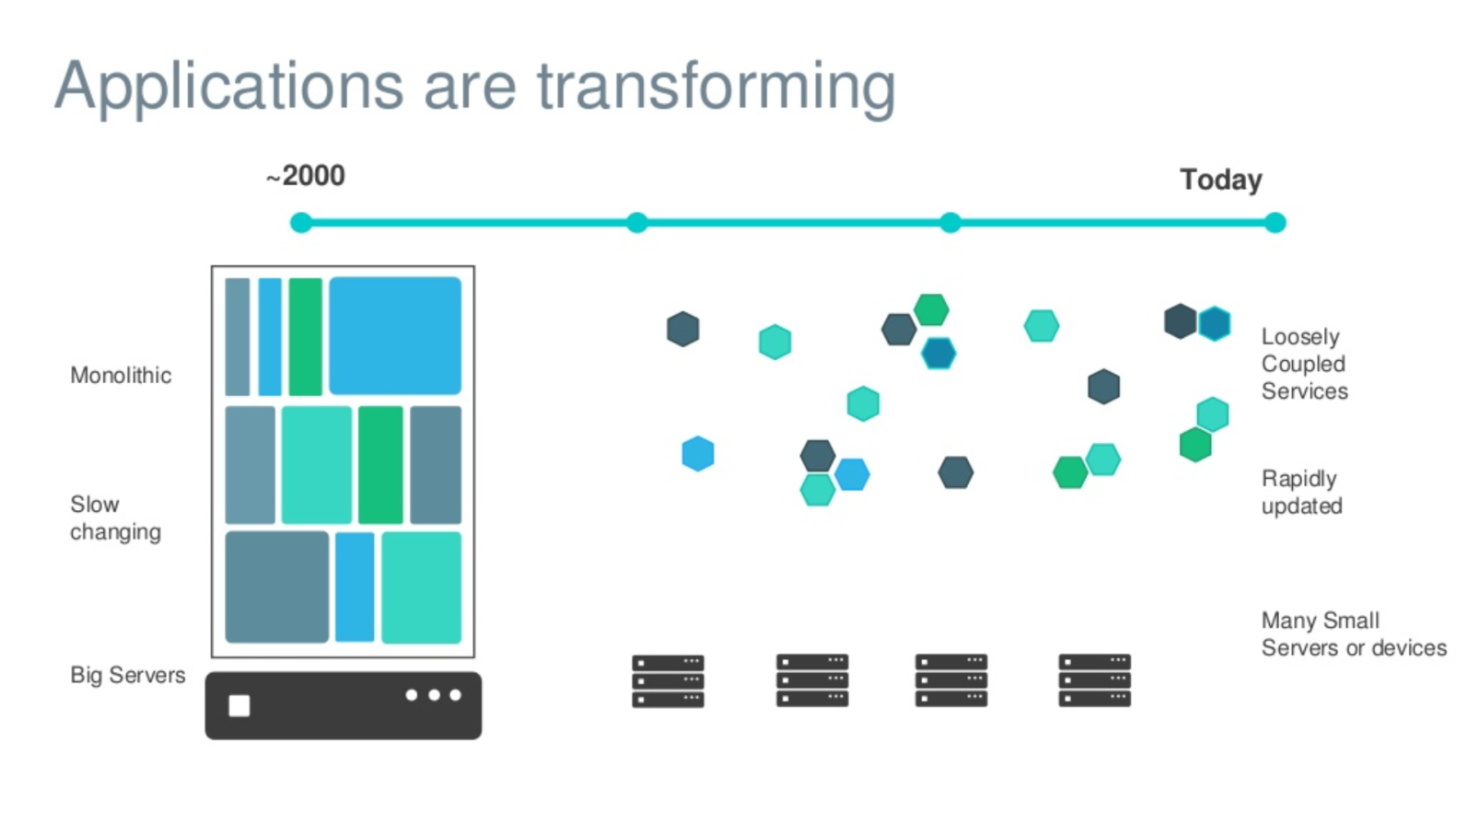
Evolving Workloads

Slide 4
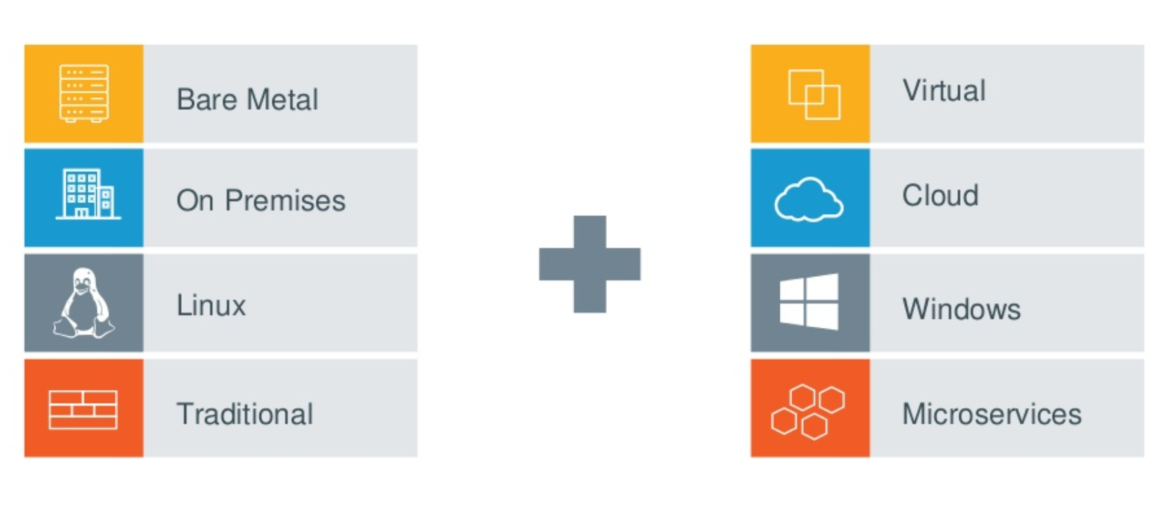
Multiple Requirements to Fill

Slide 5
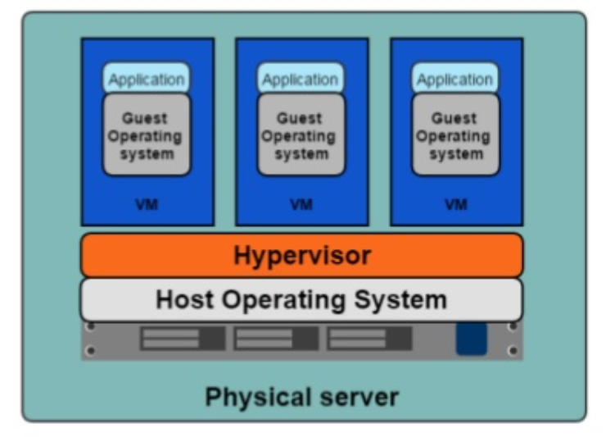
Hypervisor Based Deployments
One physical server can host multiple applications
Each application runs in a virtual machine (VM)

Slide 6
Virtual Machines – Pros & Cons
Each VM Requires its own resources
You need more resources to run more VMs
Application portability is not guaranteed
Easier to Scale
Better Resource Pooling
Supported by Cloud Platforms

Slide 7
Containers
An object for holding or transporting something
Standardized packaging for software and dependencies
Share same OS Kernel
Isolate apps from each other
Lightweight, Isolated and Fast to Boot

Slide 8
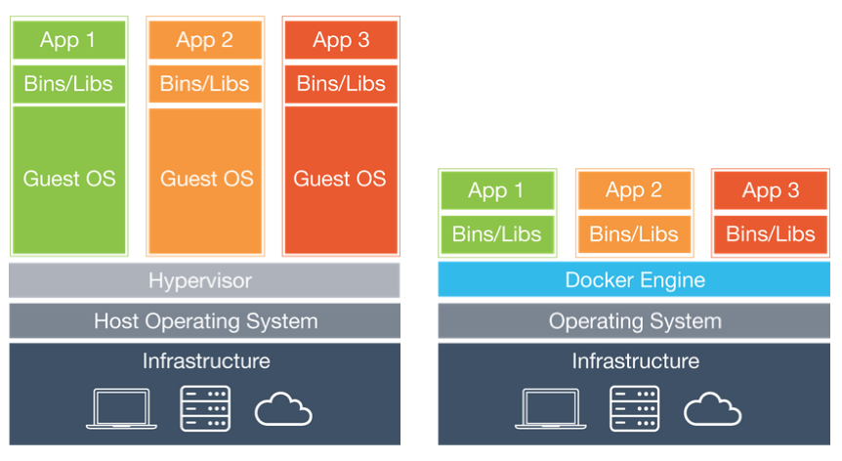
VMs Vs Containers
Infrastructure level construct
App level construct

Slide 9
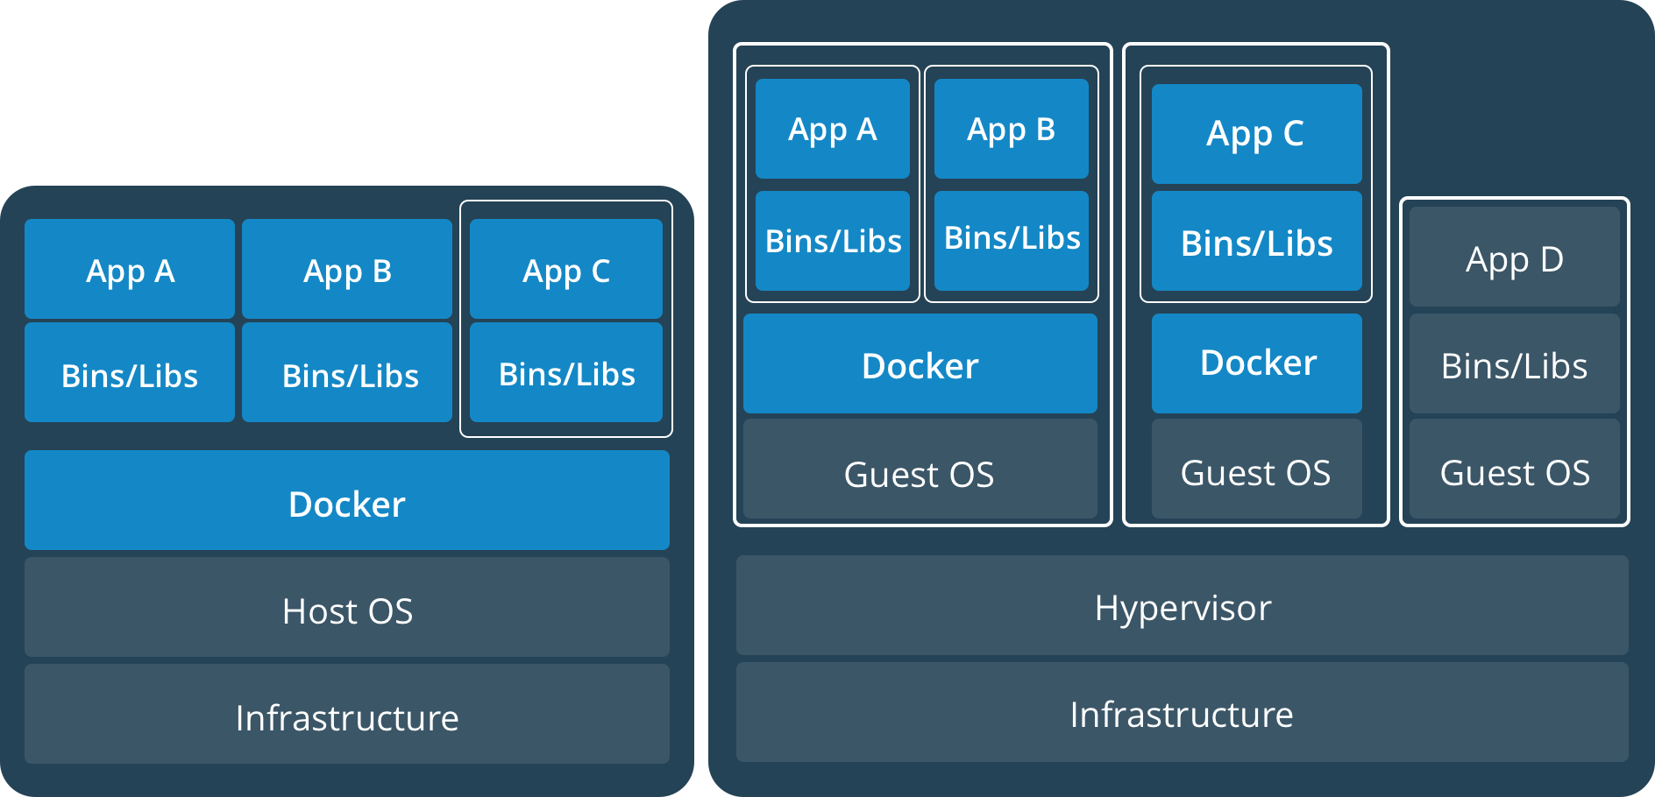
Containers AND VMs
Containers can run on standalone physical server and virtual machines
Provides tremendous flexibility for organizations
Deploy and manage apps

Slide 10
What is Docker?
Docker is an open platform for developers and sysadmins to build, ship, and run distributed applications, whether on laptops, data centre VMs, or the cloud.
Docker is a technology to package an application and all its dependencies into a single, easily transportable container
Fixes the traditional “But it works on my machine” problem

Slide 11
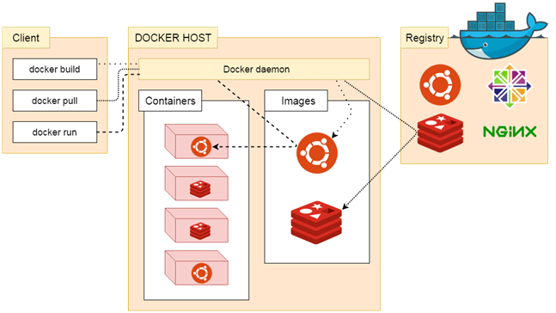
Docker Architecture
Docker uses a client-server architecture.
The Docker client talks to the Docker daemon, which does the heavy lifting of building, running, and distributing your Docker containers.
The Docker client and daemon can run on the same system, or you can connect a Docker client to a remote Docker daemon.
The Docker client and daemon communicate using a REST API, over UNIX sockets or a network interface.

Slide 12
Docker – Lab 1
Run “Hello World” Docker Container
Uses image from Docker Hub

Slide 13
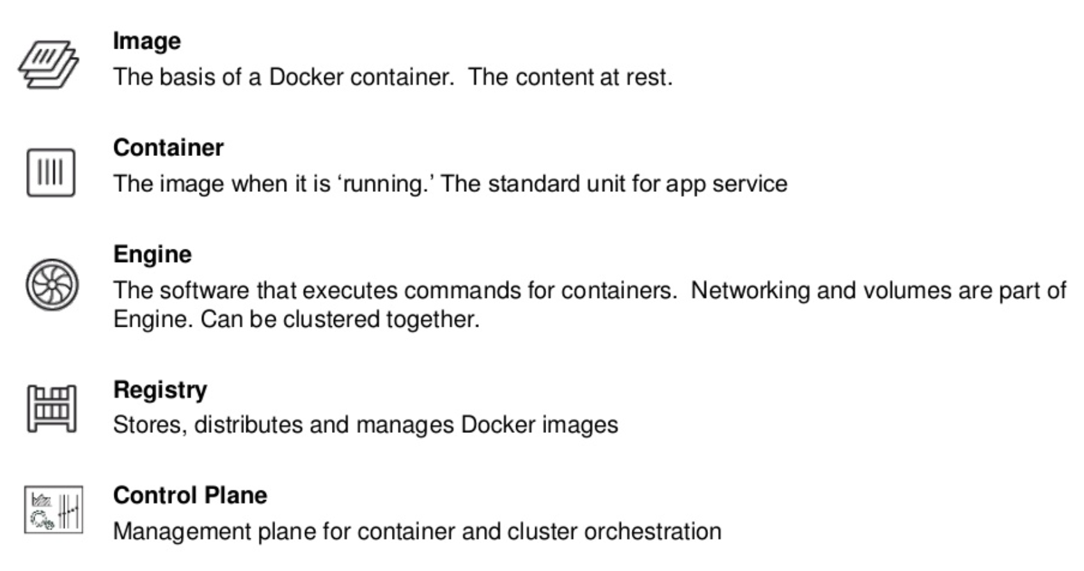
Docker Basics

Slide 14
Images
In Docker, everything is based on Images
An image is a read-only template with instructions for creating a Docker container
Usually an image is based on another image, with some additional customization.
For example, you may build an image which is based on the ubuntu image, but installs the Apache web server and your application, as well as the configuration details needed to make your application run.

Slide 15
Containers
The basic purpose of Docker is to run containers
A container is a runnable instance of an image
You can create, start, stop, move, or delete a container using the Docker API or CLI
When a container is removed, any changes to its state that are not stored in persistent storage disappear
A container is defined by its image as well as any configuration options you provide to it when you create or start it

Slide 16
Containers Cont.
Container can expose ports and volumes to interact with other containers or/and outer world
Containers are always created from images
Containers gives you instant application portability
All containers must use the same operating system
A container is defined by its image as well as any configuration options provided to it when it is created or started

Slide 17
Lab 2 – Run Container Using an Image
Uses nginx image
Container is exposed on port 80
Runs in detached mode

Slide 18
Lab 3 – Portainer
UI for Managing Docker
Runs on 1 Container
Uses Persistent Storage (Volume)
Multi Tier Web Application

Slide 19
Dockerfile
A text document that contains all the commands, in order, a user could call on the command line to assemble an image
Build instructions to build the image
Usually dockerfile is called Dockerfile
Located in root of context
docker build -f /path/to/a/Dockerfile .

Slide 20
Dockerfile Instructions
A Dockerfile must start with a `FROM` instruction
The FROM instruction specifies the base image from which you are building
Docker treats lines that begin with # as a comment

Slide 21
Lab 4 – Create Image Using Dockerfile
Uses Docker “Build” Command
Creates an Image
Nginx Web Application

Slide 22
Individual Assignment
Add Your Name to Output
App Should be Accessible Through Port 80 (Similar to Lab 4)

Slide 23
Lab 5 – Dockerize Java App

Slide 24
Lab 6 – Dockerize .NET App

Slide 25
Lab 7 – Dockerize Python App

Slide 26
Docker Hub
Docker Hub is a cloud-based registry service
Docker users and partners create, test, store and distribute container images
Centralized resource for container image discovery, distribution and change management
User and team collaboration and workflow automation throughout the development pipeline.

Slide 27
Docker Hub - Features
Image Repositories - Lets you share images with co-workers, customers, or the Docker community at large
Organizations - Create work groups to manage access to image repositories
GitHub and Bitbucket Integration - Add the Hub and your Docker Images to your current workflows

Slide 28
Lab 8 - Docker Hub – Repositories
Create new repository in Docker Hub
Push Your Images in Docker Hub Repos
We will need these in K8 labs

Slide 29
Group Assignment
Update Python Output (Change Text to Your Team Name on Browser Output)
Share Image on Docker Hub
Only One Image Per Group
Run Container Locally to Show Output

Slide 30
Docker Compose
Tool for defining and running multi-container Docker applications
Uses YAML file for configuration
3 Step Process
Create Dockerfile with Environment Information
Define Services for Your App in YAML file
Run Docker Compose

Slide 31
Lab 9 - Docker Compose
Create App Stack using Docker Compose
Multi Tier Application
Creates 5 Container

Slide 32
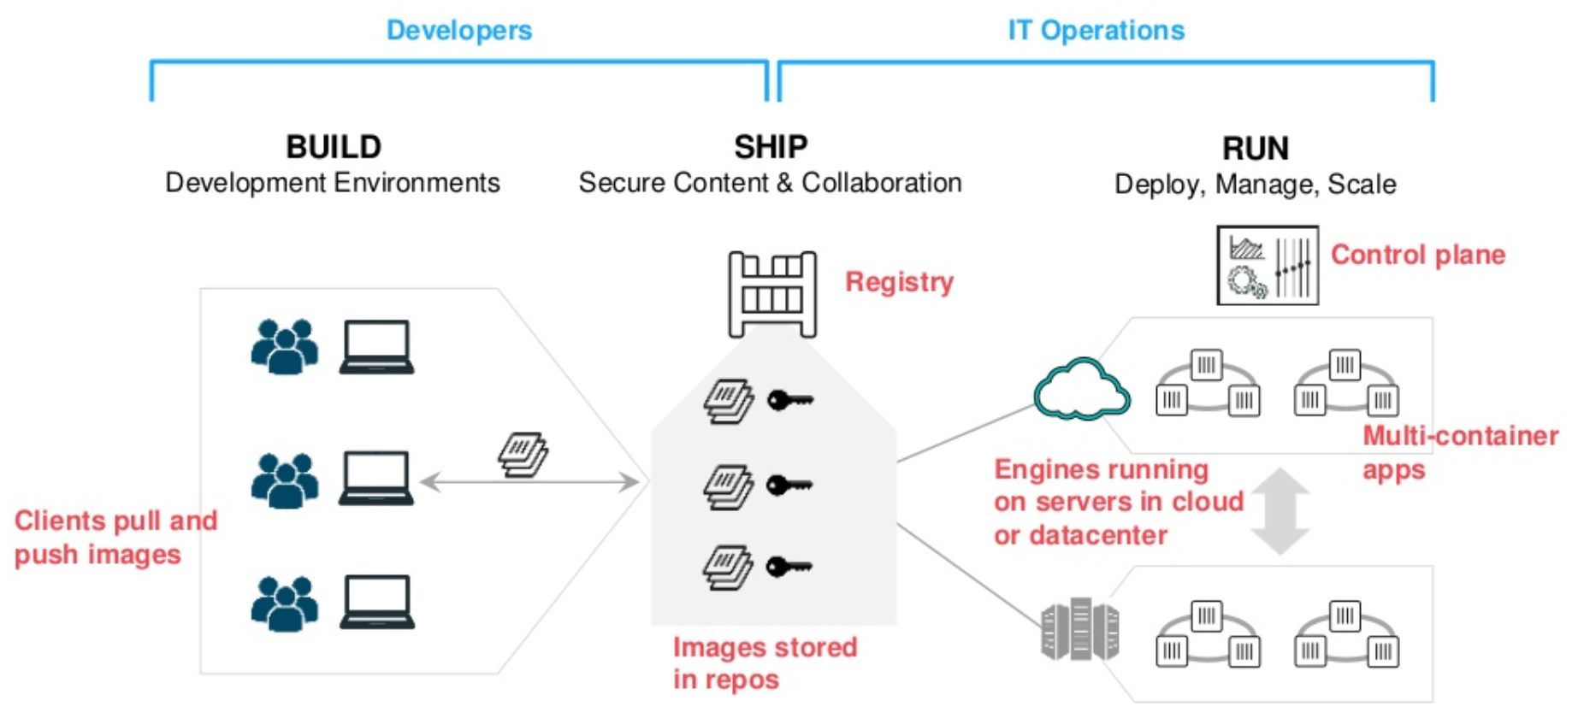
Containers as a Service

Slide 33
Advantages of Docker
Consistency
Write once, deploy anywhere
A complete platform
Manage entire lifecycle
Base engine for containers
Registry for image management
Compose for orchestration
Swarm for clustering
Machine for provisioning

Slide 34
Use Cases of Docker
Distributed Applications
Microservices
Continuous Integration
Continuous Deployment
Setting up Development Environment
Build, Ship and Run Any App, Anywhere

Slide 35
Container Best Practices
Containers should be immutable
Containers should be ephemeral
Containers should be lightweight
One container, One responsibility, One process
Store share data in volumes, not in containers
Don’t store credentials in the image

Slide 36
Docker Development Best Practices
Keep your images small
Use tags to reference specific versions of your images
Manage application data using volumes
Use official images
Store images in an organizational repository

Slide 37
This concludes Chapter 2 – Containerization with Docker

